Slide 1







Early detection and classification of breast cancer using mammogram images

Slide 2
Purpose of Project
- Breast cancer is the most frequently occurring cancer in women and involves the uncontrolled growth of abnormal breast cells that form tumors.
- If not identified and treated early, these tumors can spread throughout the body and become fatal.
- Early detection is critical to improving treatment outcomes and survival rates.
- Utilizing a CLAHE-enhanced mammogram dataset from Kaggle, the model aims to accurately classify images into two categories: Benign and Malignant.
- The proposed hybrid model combines Convolutional Neural Networks (CNNs) for local feature extraction and Vision Transformers (ViTs) for global context integration, improving early detection and diagnosis, ultimately aiding in timely treatment and reducing mortality rates.

Slide 3

Problem Statement
Breast cancer is a prevalent and potentially life-threatening condition affecting millions of individuals worldwide. Early and accurate detection of breast abnormalities from mammogram images is crucial for timely intervention and improved patient outcomes. Traditional methods rely heavily on manual interpretation by radiologists, leading to variations in diagnosis and potential oversight of subtle or early-stage abnormalities.

Slide 4

Objectives
Utilize CNNs to automatically extract relevant features such as textures, edges, and patterns from mammogram images, which are crucial for distinguishing between benign and malignant tissues.
Model Comparisons:
We are focusing on training our dataset on multiple models to check the validation accuracies and to have a report.
Aimed to identify the model that provides the highest accuracy and reliability in distinguishing between benign and malignant breast cancer images for early detection and improved patient outcomes.

Slide 5
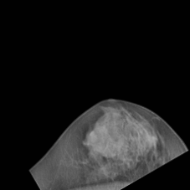
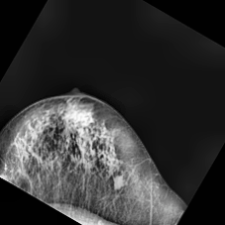
Dataset
We have a CLACHE images Dataset where we have Two classes Benign and Malignant.
These images show non-cancerous abnormalities in the breast tissue. Benign conditions can include cysts, fibroadenomas, and calcifications that do not spread or pose a significant threat to health.
These images indicate the presence of cancerous tumors in the breast tissue. Malignant tumors are characterized by uncontrolled cell growth and have the potential to invade surrounding tissues and metastasize to other parts of the body.
Benign
Malignant

Slide 6
Problems in existing models
· CNNs are highly effective at capturing local features due to their convolutional layers but may struggle with capturing long-range dependencies.
· ViTs often require large amounts of data and computational power to train effectively, as they lack the inherent inductive biases of CNNs.
· YOLO models are effective for object detection but can struggle with fine-grained classification tasks and feature extraction from medical images.
· While EfficientNet is designed for high performance with fewer parameters, it may still miss out on capturing long-range dependencies and global context.
· Some models are designed for image segmentation but may have limitations in handling complex and varied datasets, particularly in medical imaging where the structures can be subtle and varied.

Slide 7
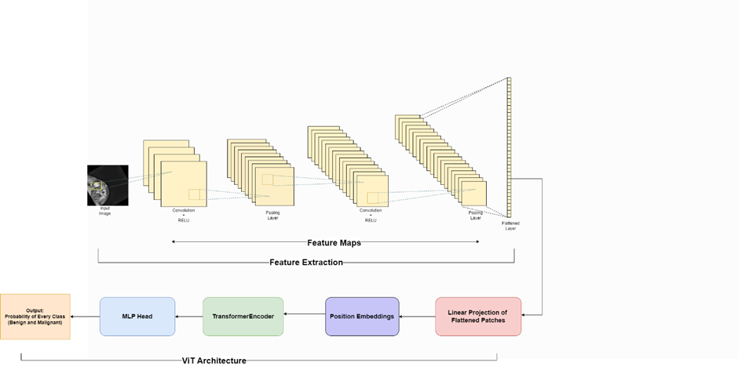
Diagram

Slide 8
Multiple Models
We have worked on several models to improve our accuracy of the Dataset:
1. Hybrid Model of CNN and ViT
2. DenseNet
3. Inception
4. SE-ResNet
5. CNN

Slide 9
Hybrid Model
DenseNet
The hybrid model leverages Convolutional Neural Networks (CNNs) for local feature extraction from gray-scaled mammogram images, capturing intricate details such as edges and textures. Vision Transformers (ViTs) are then used to integrate global context, enabling the model to understand broader patterns and relationships within the image. This combination enhances the model's ability to distinguish between benign and malignant abnormalities, improving early detection and diagnosis accuracy.
DenseNet, or Densely Connected Convolutional Network, is employed to analyze gray-scaled mammogram images by creating direct connections between each layer and every other layer in a feed-forward manner. This architecture improves feature propagation, reduces the number of parameters, and enhances the detection of subtle patterns, aiding in accurate classification of benign and malignant breast abnormalities.

Slide 10
Inception
SE-Resnet
The Inception model, also known as GoogLeNet, processes gray-scaled mammogram images by employing parallel convolutional layers of varying sizes within its inception modules. This approach allows the model to capture multiple spatial hierarchies and extract comprehensive features, enhancing its ability to accurately differentiate between benign and malignant breast abnormalities.
SE-ResNet, or Squeeze-and-Excitation ResNet, enhances gray-scaled mammogram image analysis by integrating squeeze-and-excitation blocks into the ResNet architecture. These blocks adaptively recalibrate channel-wise feature responses, improving the network's sensitivity to important features and thereby increasing the accuracy in distinguishing between benign and malignant breast abnormalities.

Slide 11
CNN
Convolutional Neural Networks (CNNs) are pivotal in analyzing gray-scaled mammogram images due to their ability to automatically learn and extract hierarchical features. They consist of convolutional layers that apply filters across the input image, capturing local patterns like edges and textures relevant to breast abnormalities. Pooling layers then condense the spatial dimensions, focusing on the most salient features.
CNNs are often augmented with activation functions like ReLU to introduce non-linearity, enhancing model complexity. Multiple convolutional and pooling layers allow CNNs to progressively learn more abstract features, crucial for tasks like distinguishing between benign and malignant conditions in mammogram images.

Slide 12
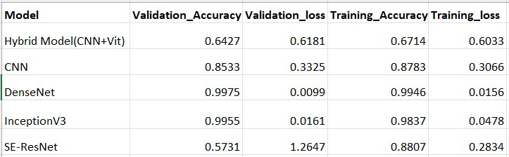
Accuracies Table

Slide 13
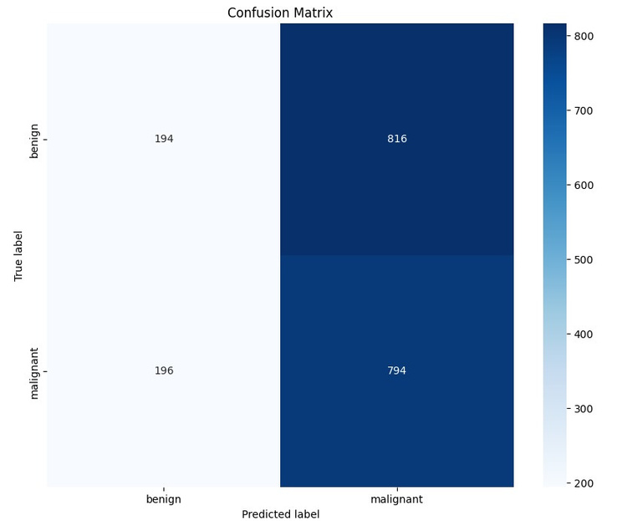
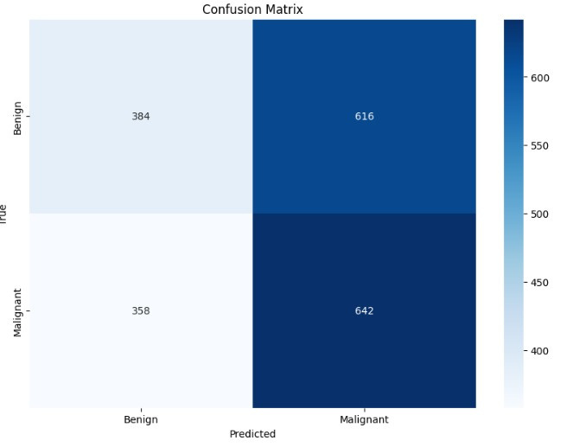
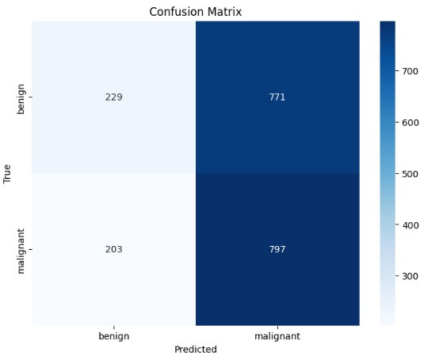
Confusion Matrices
Hybrid Model
CNN
SE-RESNET

Slide 14
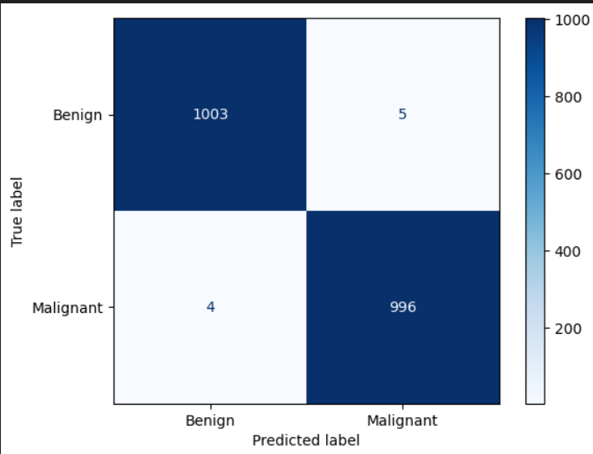
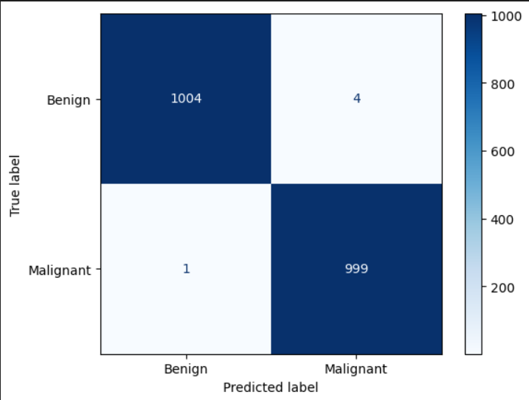
Confusion Matrices
Inception V3
DenseNet

Slide 15
Thank you!

